Slide 1



CHART CLASSIFICATION

Slide 2
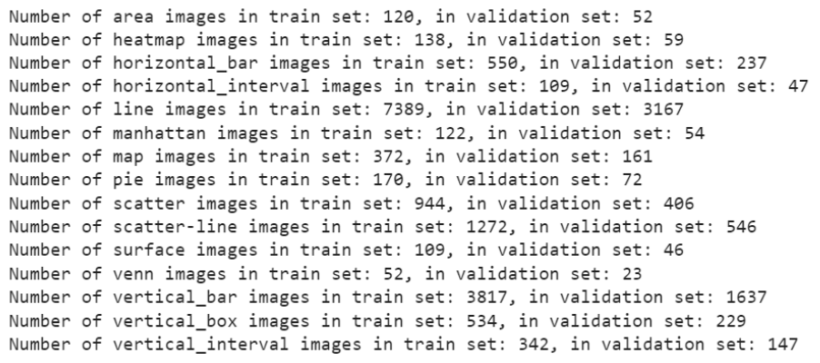
DATASET DISTRIBUTION
Total training dataset of approximately 22000 images
First case: 80% train, 20% validation
Second case: 70% train, 30% validation

Slide 3
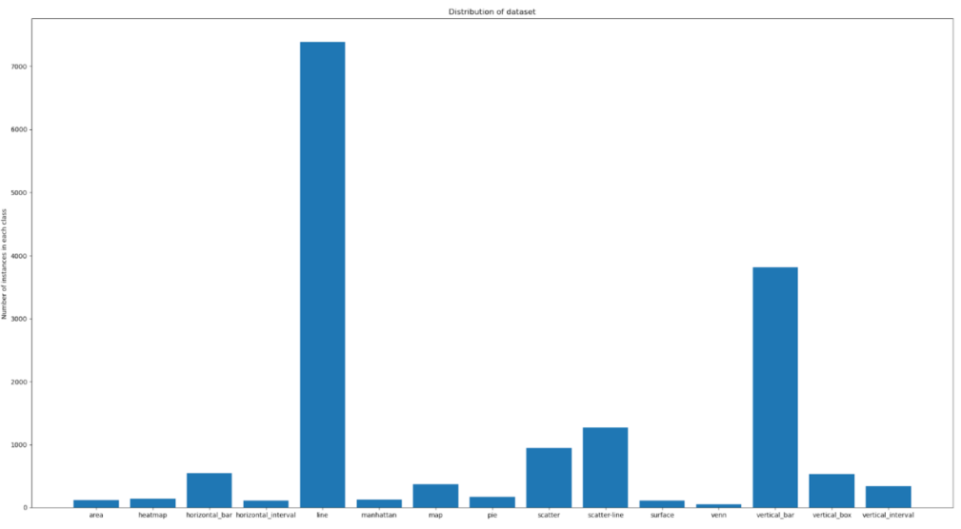
DISTRIBUTION OF EACH CLASS IN TRAINING SET
APPROXIMATE 22000 IMAGES

Slide 4
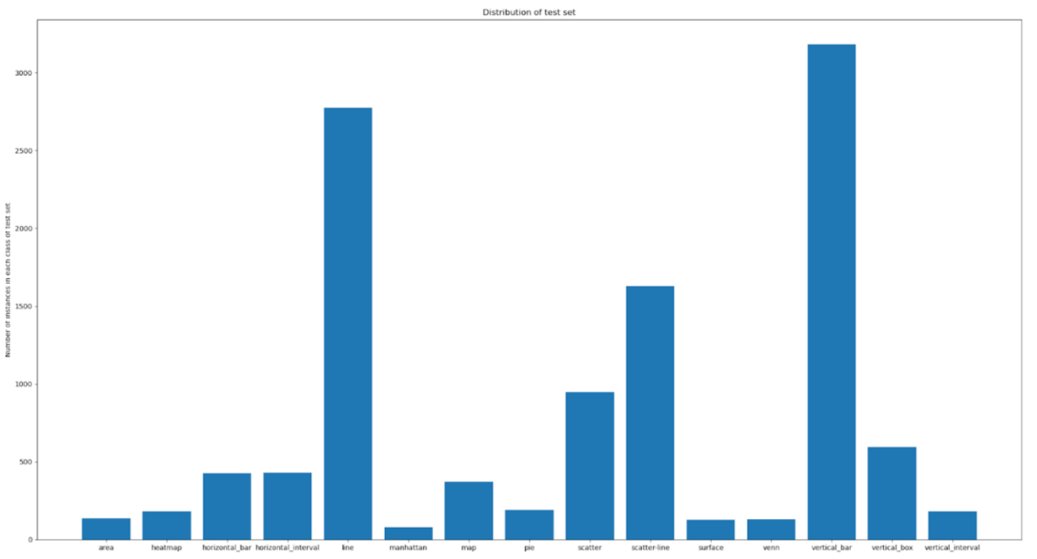
DISTRIBUTION OF EACH CLASS IN TESTING SET
APPROXIMATE 11000 IMAGES

Slide 5


CHOOSING HYPERPARAMETERS
Batch size: 16 (due to hardware limitation and model size)
Learning rate: 0.001
Initial steps: StepLR ( Fast at some first epochs and slow down at the few last epochs
Last steps: ReduceOnPlateau (Some last epochs whenever the training loss doesn’t decrease anymore, it will reduce the learning rate)
Regularization: Dropout (0.2-0.5)
Metric: F1 macro (In the context of an imbalanced dataset where equal importance is attributed to all classes, opting for the macro average stands as a sound choice since it treats each class with equal significance

Slide 6
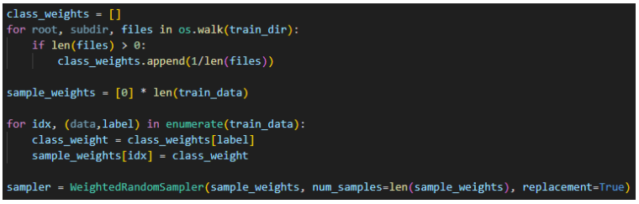
DATA PREPROCESS
The dataset is imbalanced, the Weighted Random Sampler method is necessary for us to make the dataset more balanced and the model will evaluate each class equally.

Slide 7
MODEL SELECTION
Following the paper of ICDAR 2019, There 2 popular models which are Resnet101 and Resnet50, so I will continue with those 2 models and one more which is Efficientnet_V2_S.
Applying transfer learning, I won’t freeze the previous layers of the pretrained models because this type of dataset is unique, so letting the model learn from scratch is my choice.
For augmentation or transformation for training and evaluating process, I am using pretrained transformation of that specific model.

Slide 8
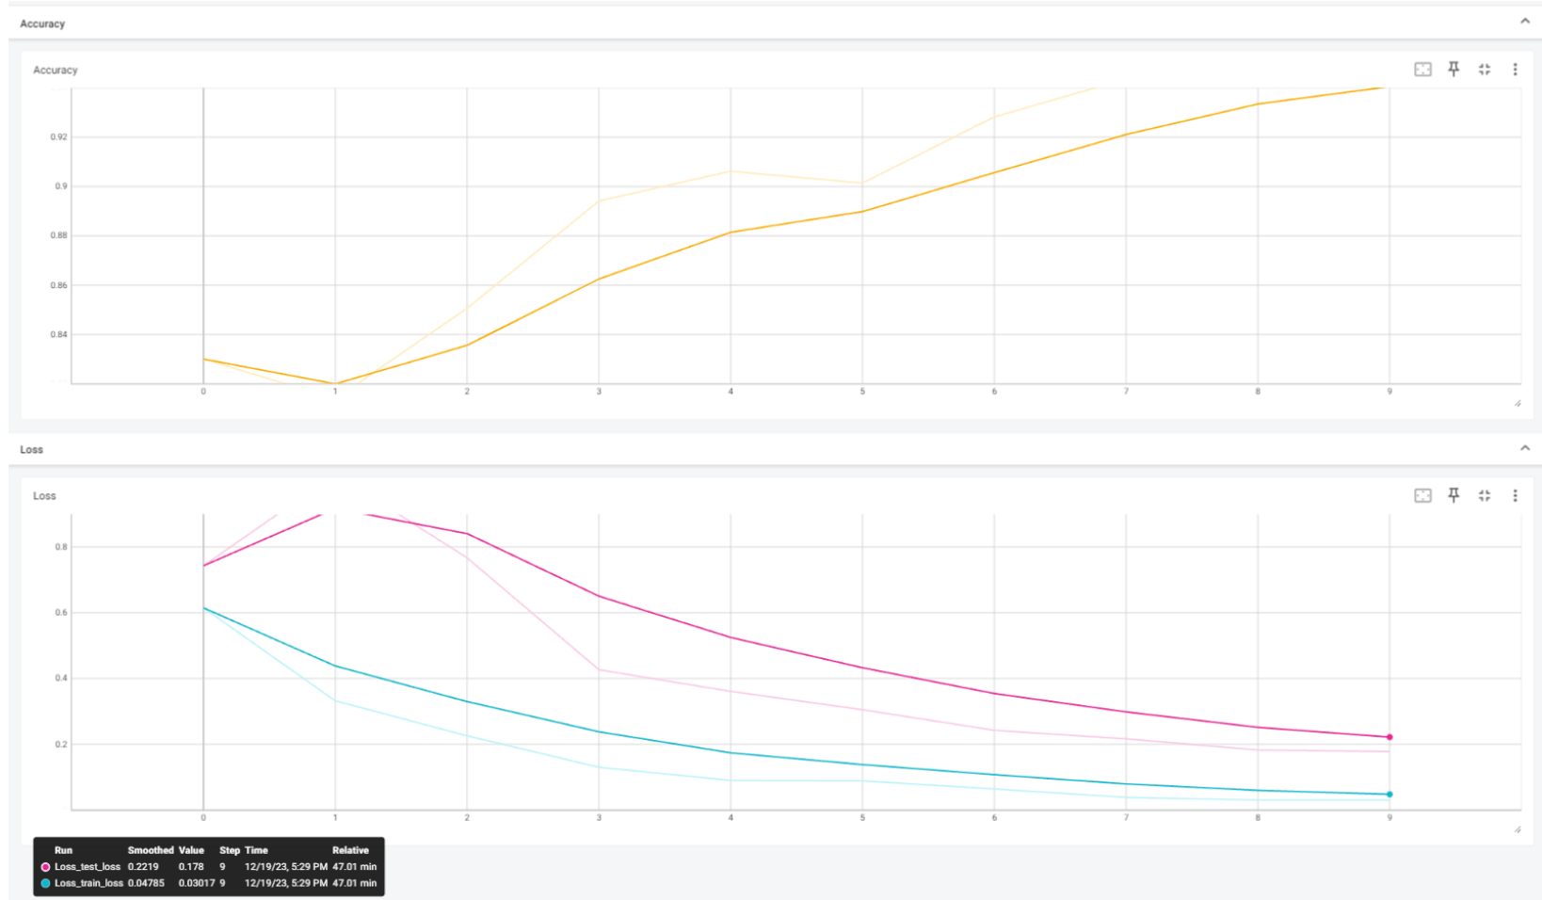
TRAINING PROCESS
Efficientnet_v2s first 10 epochs:

Slide 9
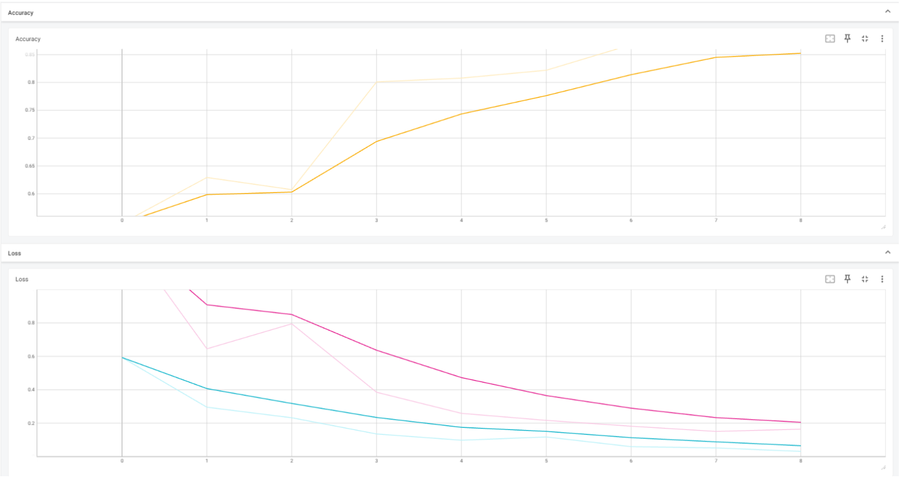
TRAINING PROCESS
Resnet50 first 10 epochs:

Slide 10
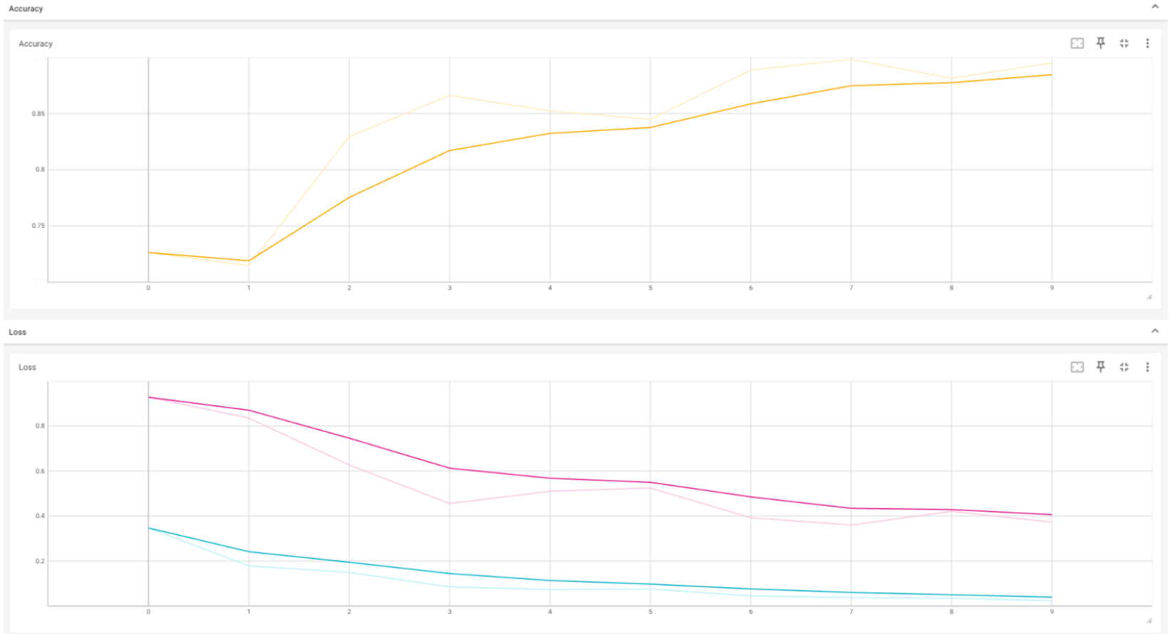
TRAINING PROCESS
Resnet101 first 10 epochs:

Slide 11
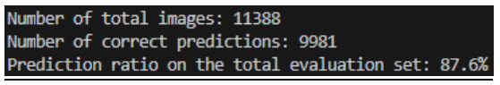
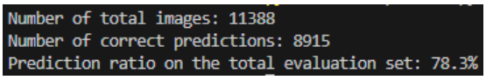
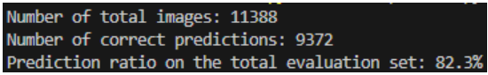
MODEL EVALUATION
At the first 10 epochs, 3 models all reach a good F1 score with an evaluation F1 score almost higher than 80%. Both training and validating loss all decrease so that is a good signal for our training process
To guarantee the models won’t overfit so we bring the models to evaluate the approximate 11k images test set that already have the Ground Truths.
Effiecientnet_v2s
Resnet101
Resnet50

Slide 12
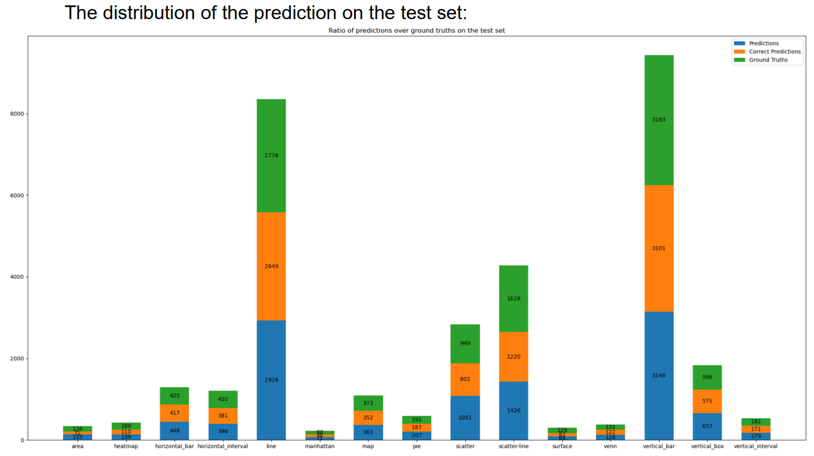
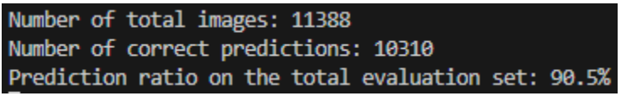
MODEL EVALUATION
FINAL RESULTS
Efficientnet_v2s

Slide 13
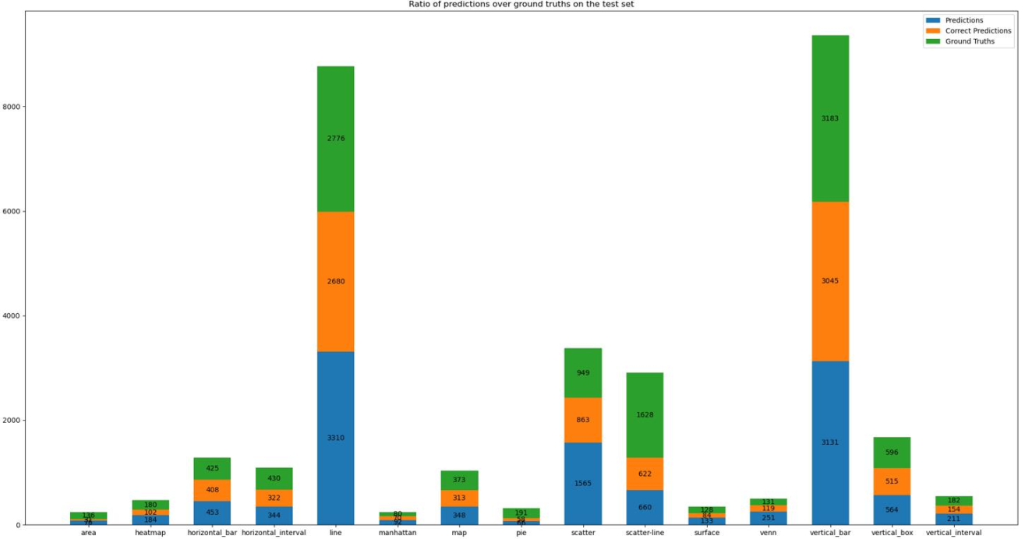
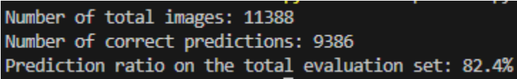
MODEL EVALUATION
FINAL RESULTS
Resnet101

Slide 14
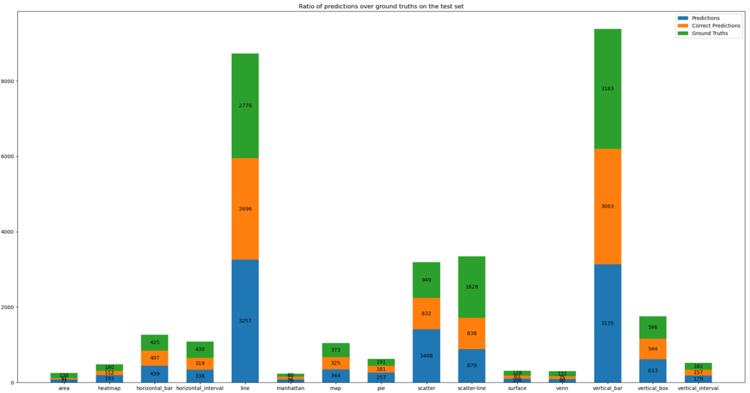
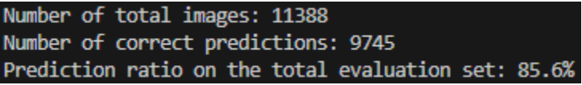
MODEL EVALUATION
FINAL RESULTS
Resnet50

Slide 15
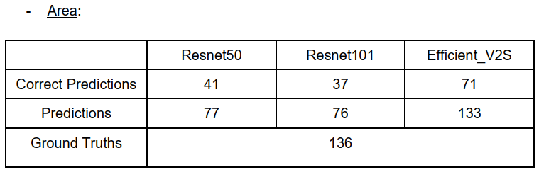
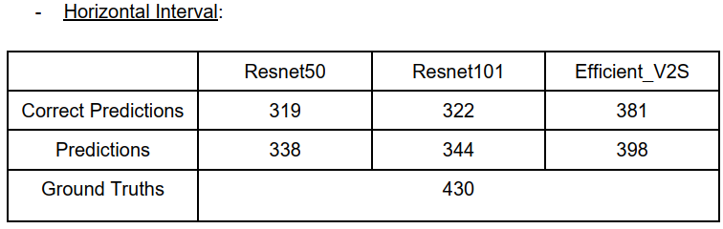
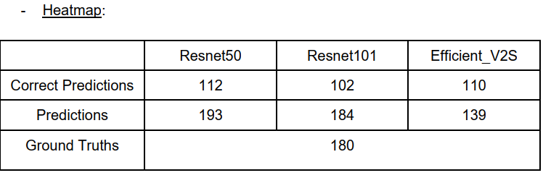
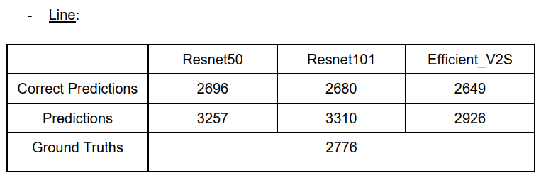
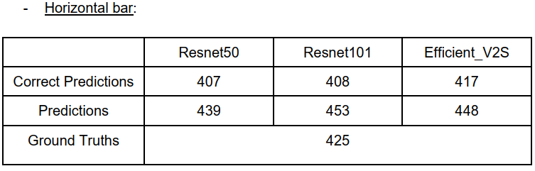
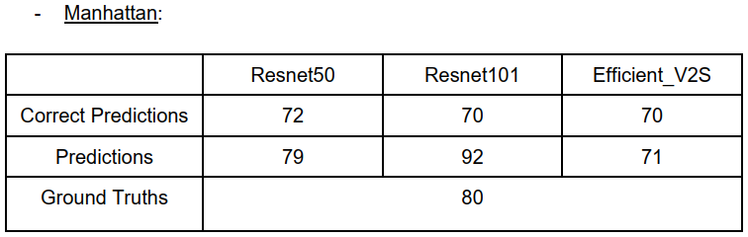
COMPARISON

Slide 16
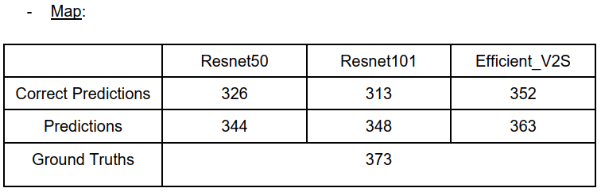
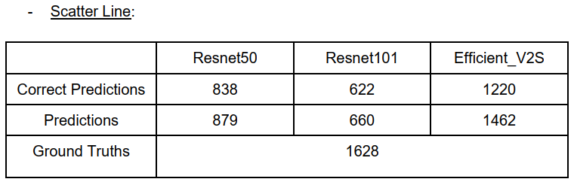
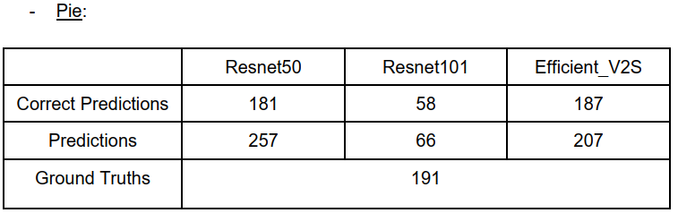
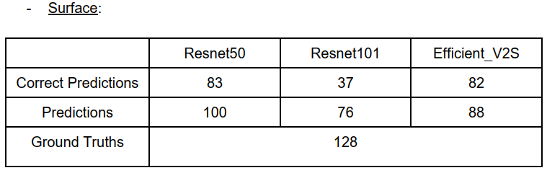
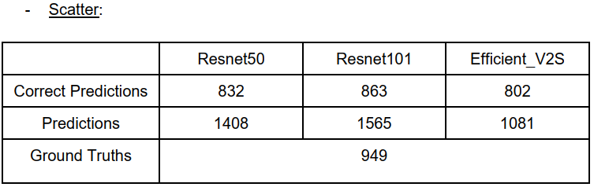
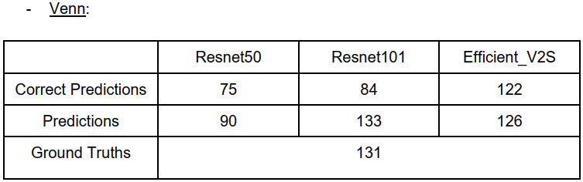
COMPARISON

Slide 17
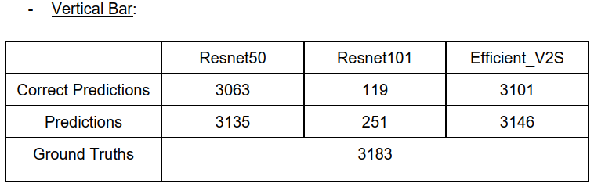
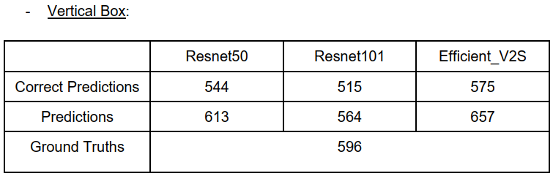
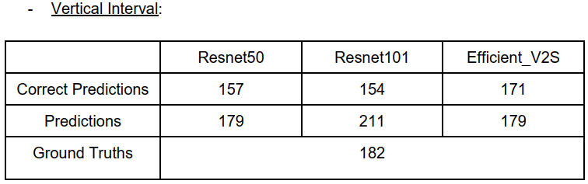
COMPARISON

Slide 18
COMPARISON
Efficient V2S is outstanding compared to others. For Efficient_V2S, these charts are classified surprisingly good in spite of not having many training samples such as Vertical Interval, Venn, Pie, Map, Manhattan, Horizontal Bar.
For the Line class having the one of the largest training samples, the correct predictions out of ground truths is quite good with 2696/2776. Although it might perform quite well, there is a weakness: the model predicts the test sample for this class too much (3257). This can gain a lot of False Positive (not Line chart is being classified as Line).
In contrast with Line, Vertical Bar, which also has lots of training samples, is being classified really good (3135 predicted as Vertical Bar out of 3183 Ground Truths and having 3063/3135 correct prediction)

Slide 19
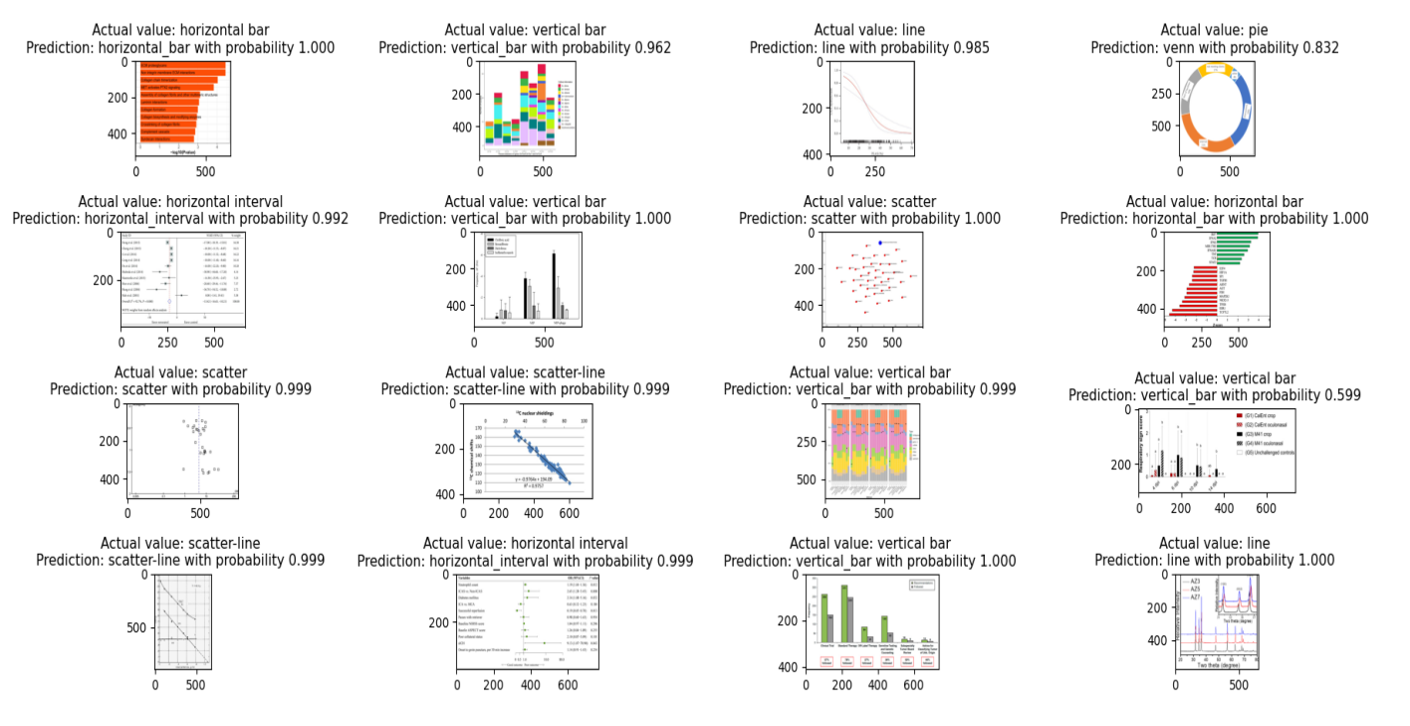
IMAGE PREDICTIONS

Slide 20
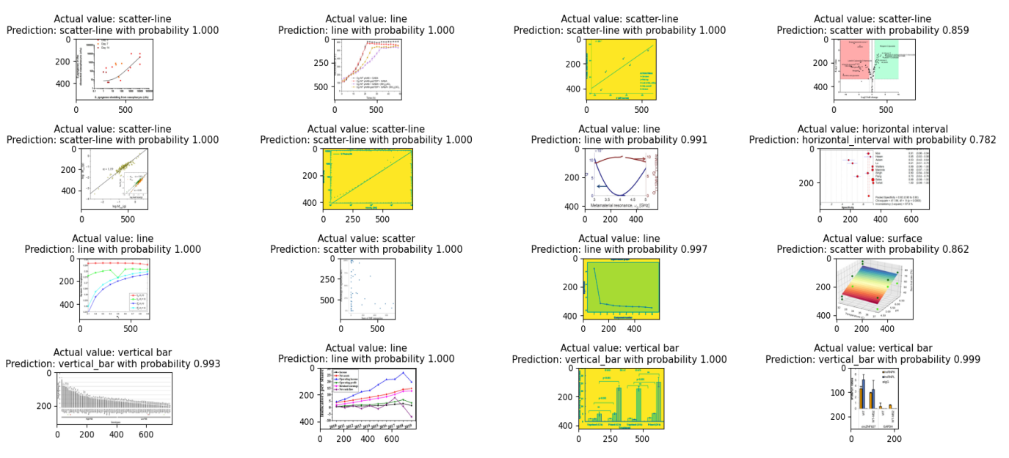
IMAGE PREDICTIONS

Slide 21
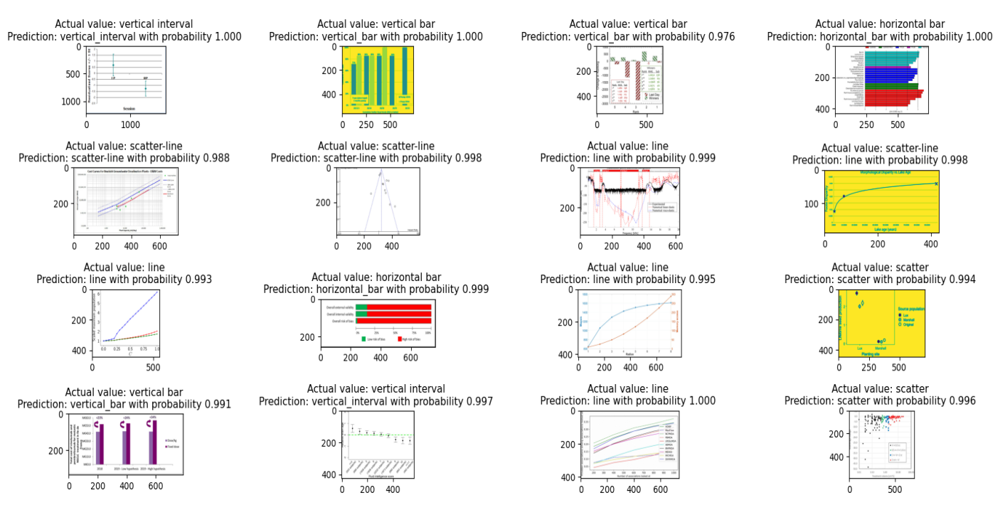
IMAGE PREDICTIONS

Slide 22
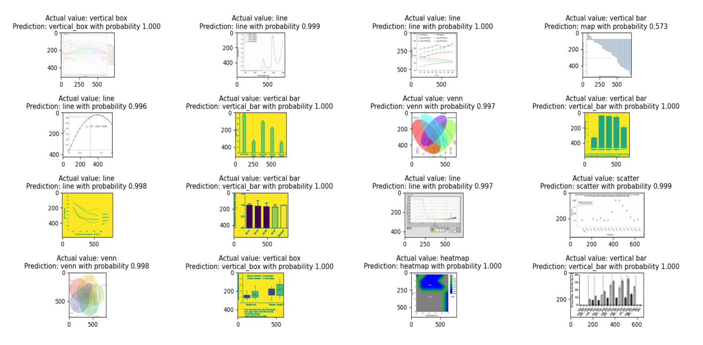
IMAGE PREDICTIONS

Slide 23
THANK YOU
Presentation by Alexander Aronowitz
Business Marketing | 2024
Rimberio University

